Slide 1
Understanding Institutional diversity
By Elinor Ostrom
Presented by Zhenhuan Lei

Slide 2
Questions to answer
Question: Why institutional diversity?
1. Ostrom: micro-level, contextual setting
2. North (1990): Macro-level, interaction between institutions and organizations.
Question: Why institutions?
Hobbes: Leviathan-benevolent dictatorship (vs Machiavelli)
Rousseau: reciprocity; social condition; liberty vs general will
Tocqueville: Self-interest rightly understood

Slide 3
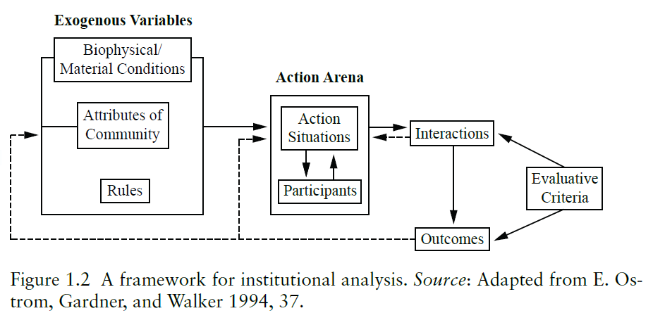
Zooming out

Slide 4
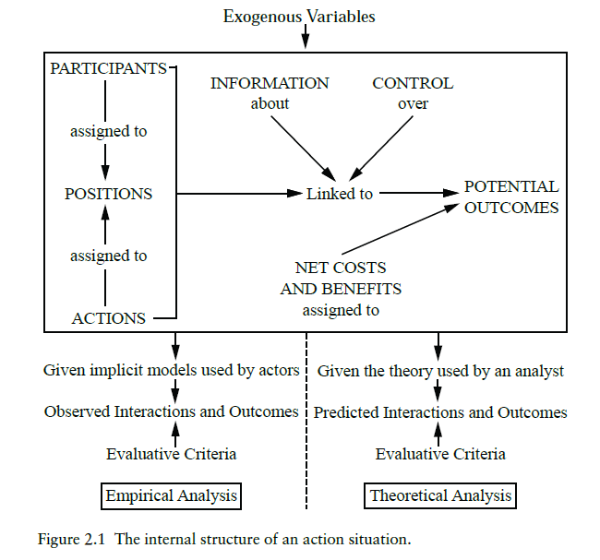
Zooming in

Slide 5
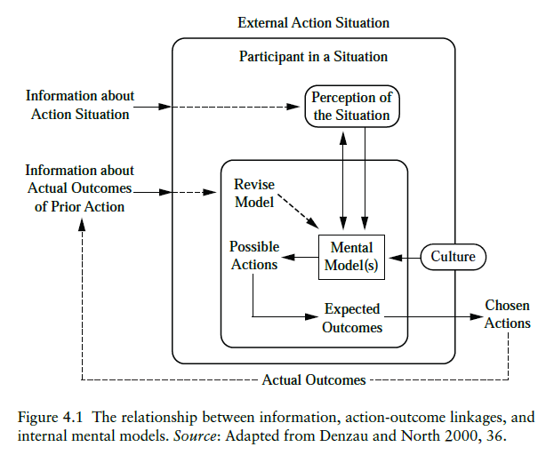
Rational choice?
North (1990):
Motivation
Limited thinking mode
Asymmetric information
Ostrom (2006):
Rational Choice Theory is used mainly in quasi-complete comparative market (financial market).
Information feedback matters

Slide 6
Rules vs norms
Example 1: All senators may move to amend a bill after a bill has been introduced, or else the senator attempting to forbid another senator from taking this action by calling him or her out of order will be called out of order or ignored.
Example 2: The person who places a phone call, calls back when the call gets disconnected.
Example 3: All villagers must not let their animals trample the irrigation channels, or else the villager who owns the livestock will have to pay a fine.

Slide 7
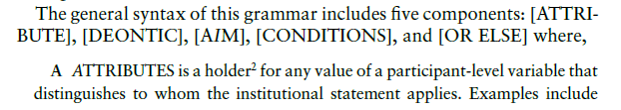
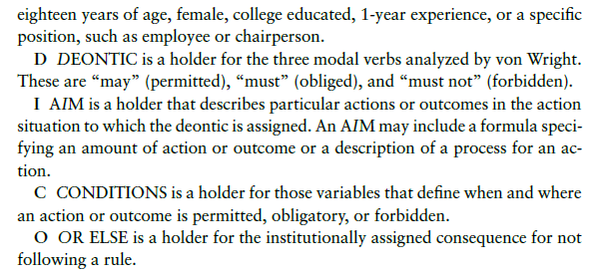
Grammar of rules

Slide 8
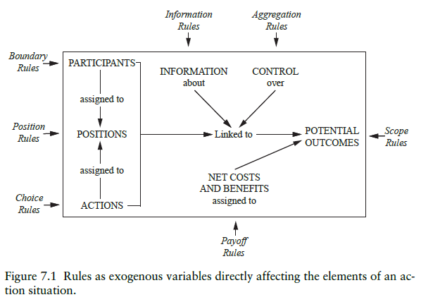
Classifying rules

Slide 9
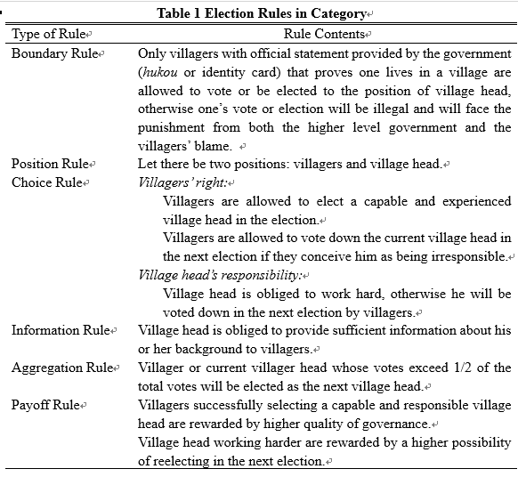
An example: Chinese village election
Help focus on interested information or policy concerns
Break down a complex institution into meaningful components
Standardize rules for comparison

Slide 10
Some words about institutional change
Cost-benefit analysis: Benefit V.S. Cost in the short run and in the long run
Example: Cheung N.S. Will China Become a Capitalist Country? (1986)
Cost of transforming to a quasi-Capitalist Country.
Costs involved: information cost (Hong Kong) and vested interests.

Slide 11
Come back: Why institutional diversity?
Complexity of institutions
Experimentation VS Exhaustive analysis
Three wrong views:
Centralized authority is better.
Objective outside policy analysts are better at providing policy suggestions.
Ordinary people are incapable of designing self-governance rules.
Suggestion: Polycentric System
Vincent Ostrom (1987) The Political Theory of a Compound Republic

Slide 12
references
Cheung, Steven N. S. 1982. Will China go "capitalist"?: an economic analysis of property rights and institutional change. Institute of Economic Affairs.
North, Douglas C. 1990. Institutions, Institutional Change and Economic Performance. New York: Cambridge University Press.
Ostrom, Elinor. 2006. Understanding Institutional Diversity. Princeton: Princeton University Press.
Ostrom, Vincent. 1987. The Political Theory of a Compound Republic: Designing the American Experiment. Lexington Books.

